Slide 1

Bachelors of Engineering
Project presentation
Department of Electronics Engineering
Sardar Patel Institute of Technology
Munshi Nagar, Andheri(W), Mumbai-400058
UNIVERSITY OF MUMBAI
2017-2018

Slide 2
A PRESENTATION ON
ROBOT DEVELOPMENT USING ROS
By
SRIJAL POOJARI
&
CHIRAG SHAH
Under the guidance of
Kumar Khandagle

Slide 3
Problem Statement
To explore the ROS framework and implementing a quadcoptor running ROS to create a 3D map of the real time environment that it sees using a depth sensor (Microsoft Kinect).
Notes:
Here I will type out the notes of whatI will be speaking
3

Slide 4
Abstract
This project deals with exploring the ROS framework for
Development of a robotic system with various sensors and actuators
To develop a quadcoptor capable of forming a 3D map of an indoor environment using a depth camera (Microsoft Kinect)

Slide 5
Introduction
What is ROS?
What is Microsoft Kinect?
What are the challenges?
Notes:
The Robot Operating System (ROS) is a flexible framework for developing software with tools, libraries and conventions that facilitate the creation of complex robot behaviour on a wide variety of robotic platforms
Kinect is Microsoft's motion sensor add-on for the Xbox 360 gaming console. The device provides a natural user interface (NUI) that allows users to interact intuitively and without any intermediary device, such as a controller.
5

Slide 6
Project Objectives
Learn the ROS framework
Understand and implement SLAM algorithms for 3D mapping
Understand the interfacing of different hardware components with ROS packages
Combine the software and hardware components to create a stand-alone quadcoptor for 3D mapping

Slide 7
Literature Survey
Huang et al. (2011). Visual Odometry For GPS-Denied Flight And Mapping Using A Kinect. MIT, University of Washington. Website.
Shen S., Michael N., Kumar V. (2010). Autonomous aerial navigation in confined indoor environments. University of Pennsylvania. YouTube.
Alessio Tonioni (2015). Autonomous quadcoptor flight in ROS. GitHub Source.
Will Selby (2016). 3D Mapping & Navigation with ROS. Website.
Belavadi S., Beri R. (2017). Indoor Environments Mapping using UAV. GitHub Source.

Slide 8
Software Requirements
Ubuntu 16.04 (Xenial Xerus)
ROS Kinetic Kame
Hardware Requirements
RGB-D Camera (Microsoft Kinect)
Quadcoptor capable of lifting payload upto 1kgs
Single Board Computer capable of running Ubuntu and ROS

Slide 9
Project Plan
Week | Objective
1 to 3 | Installing ROS, Understanding the underlying concepts.
4 to 5 | Interfacing the Microsoft Kinect sensor on Gazebo simulator.
6 to 8 | Understanding Pointclouds and RTAB Map for real time environment mapping.
9 | Interface the Kinect sensor for mapping of real world environments.

Slide 10
Results
Work done up till now involves (upto August 4, 2017)
Reading and understanding the framework of ROS
Practicing ROS commands by following the official ROS wiki
RTAB installation
“Give me six hours to chop down a tree and I will spend the first four sharpening the axe.“ - Abraham Lincoln

Slide 11
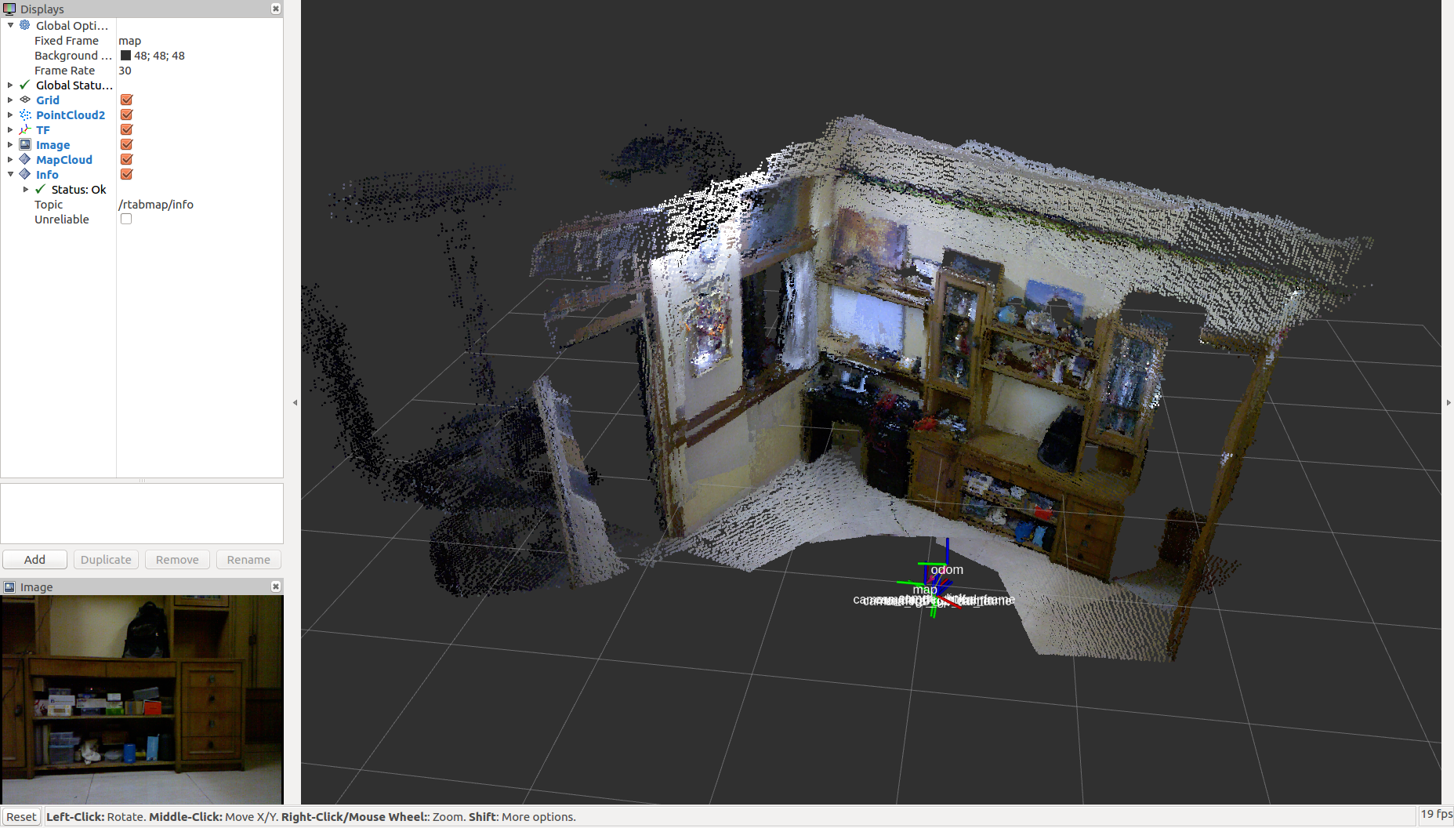
Results
Mapping using hand-held Kinect

Slide 12
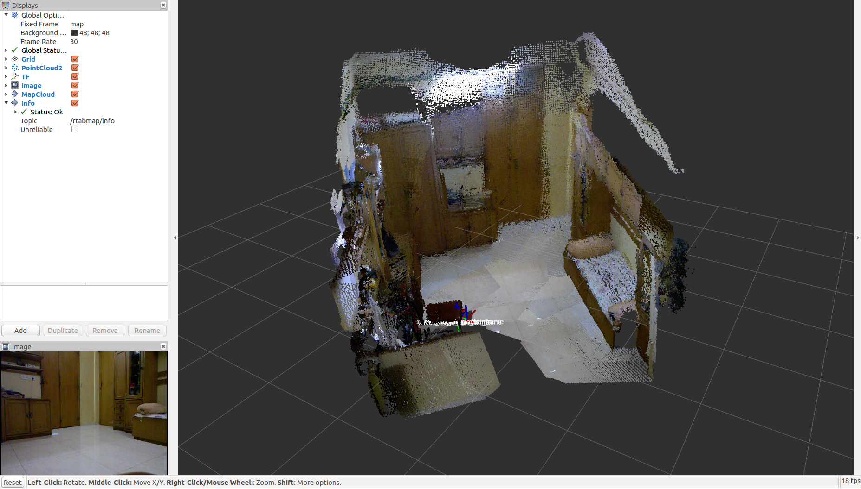
Results
Mapping using hand-held Kinect

Slide 13
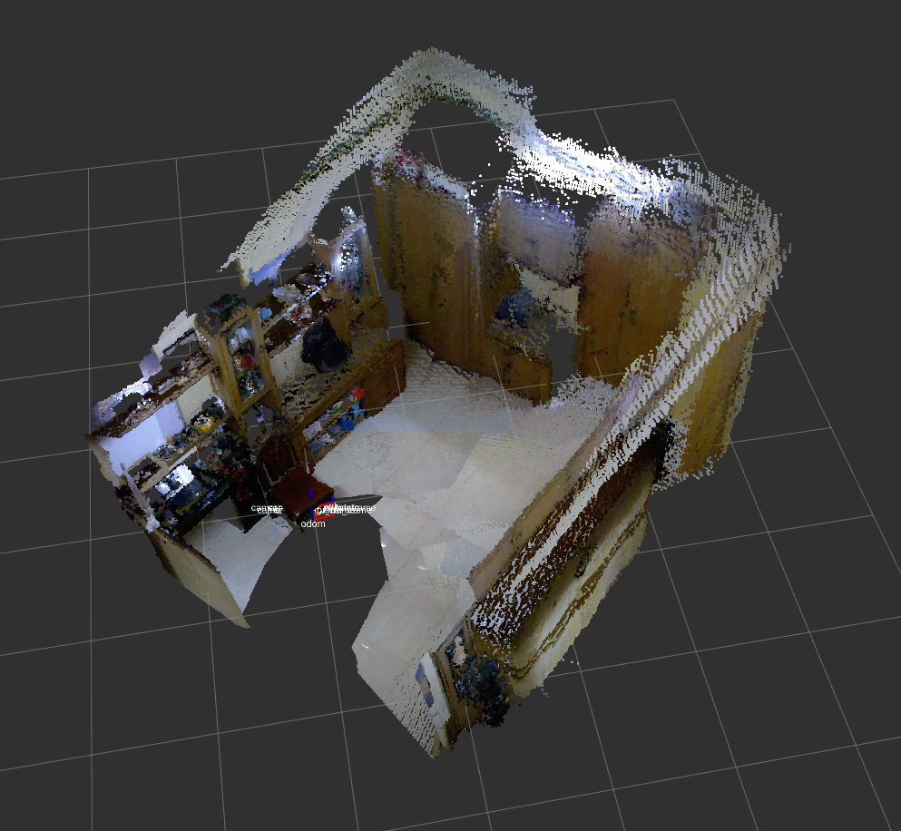
Results
Mapping using hand-held Kinect

Slide 14
Results
Potential problems with rpi and solutions
Paste pictures

Slide 15
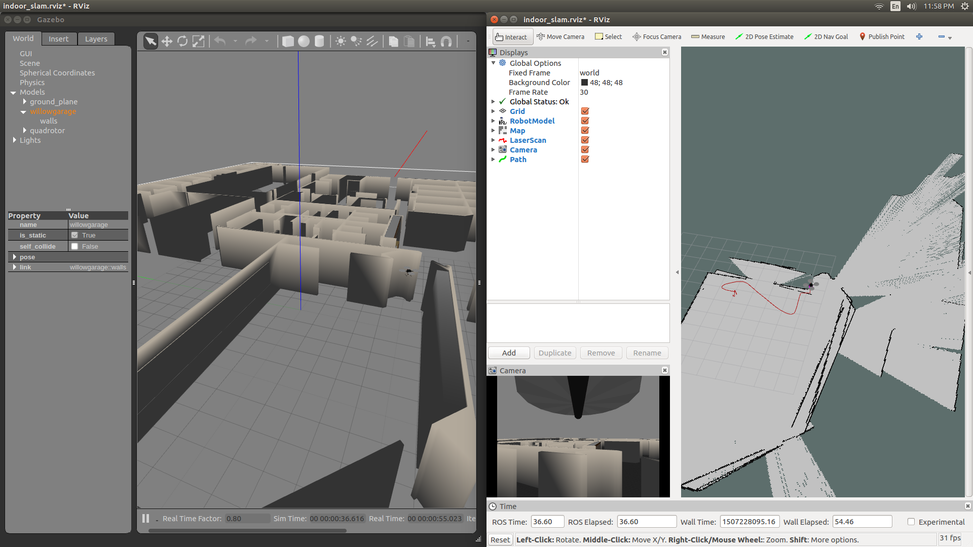
Results
Simulation using hector quadrotor package on ROS Gazebo and RViz

Slide 16
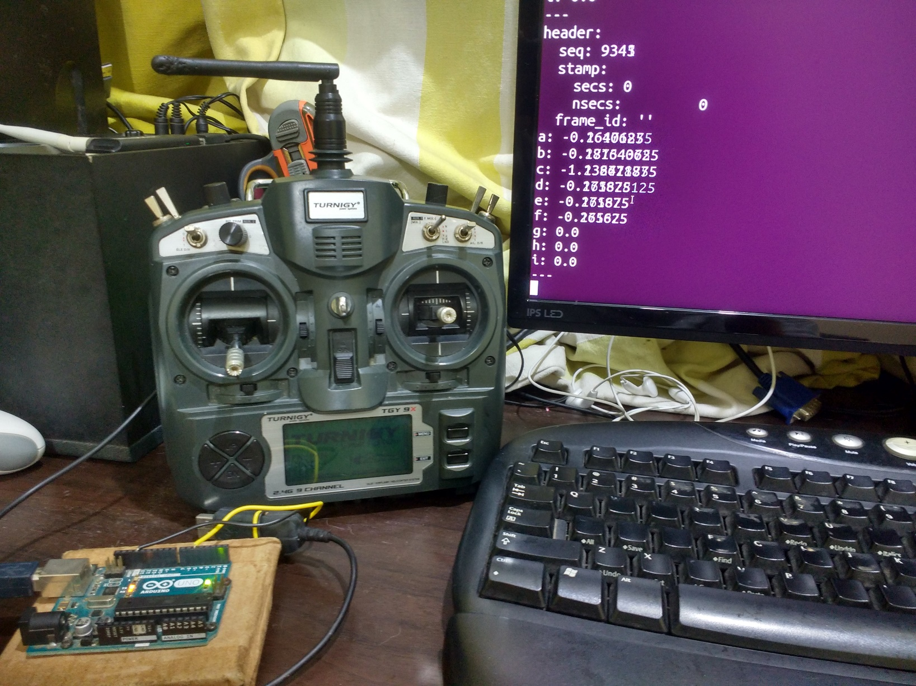
Results
Interfacing RC Transmitter with ROS

Slide 17
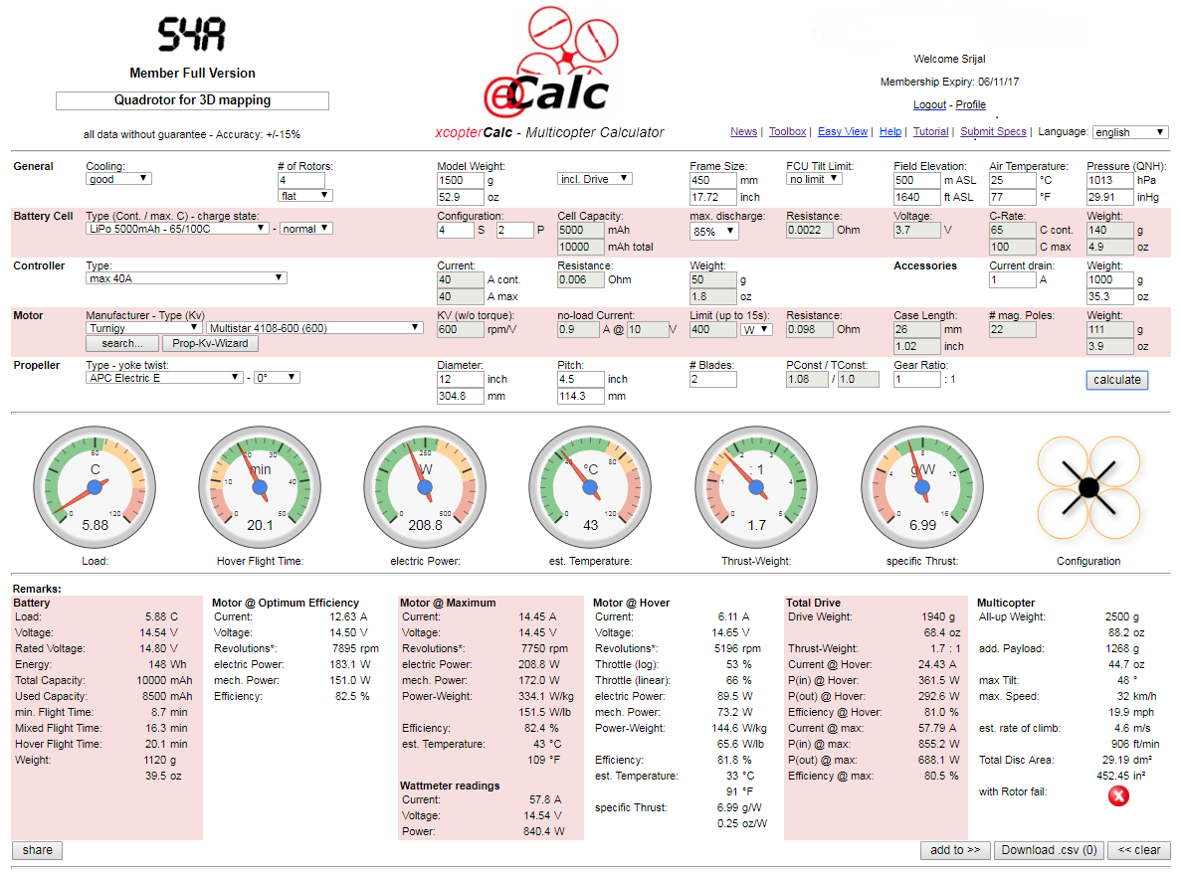
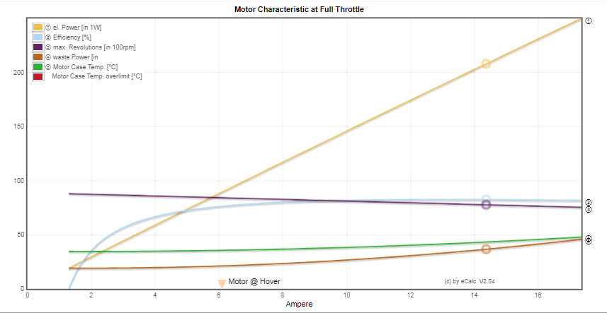
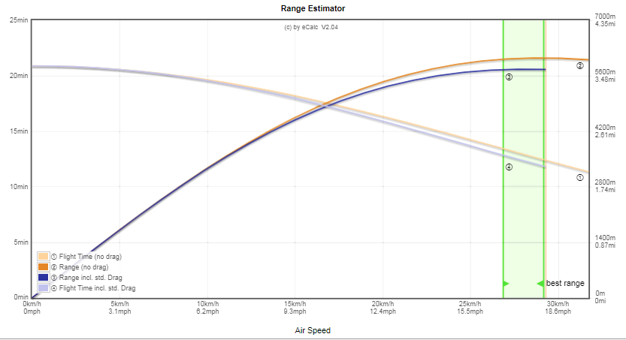
Results
Quadrotor configuration planning

Slide 18
Challenges Faced
Insufficient documentation of most packages.
Difficulty in debugging when things go wrong.
Lack of fundamentals and terminology in Robotics

Slide 19
Ongoing work
Wireless streaming of map data over the ROS network.
Selecting a light weight and small form-factor computer which can handle the required computations.
(RPi, ODROID XU4)
Building the quadrotor.

Slide 20
Foreseeable Challenges
With mapping using SBC
Drone building
Mapping with drone(stability etc)
Financing the project and conflicts with DOD over possession of lethal technology

Slide 21
Future work
ML
Object recognition
Autonomous control
AI to rule the world

Slide 22
References
Official ROS Documentation : http://wiki.ros.org/
ROS Forums : https://answers.ros.org
Quigley, M., Gerkey, B. and Smart, W. (2015). Programming robots with ROS. Sebastopol, California: O'Reilly Media.

Slide 23
THANK YOU

